Slide 1
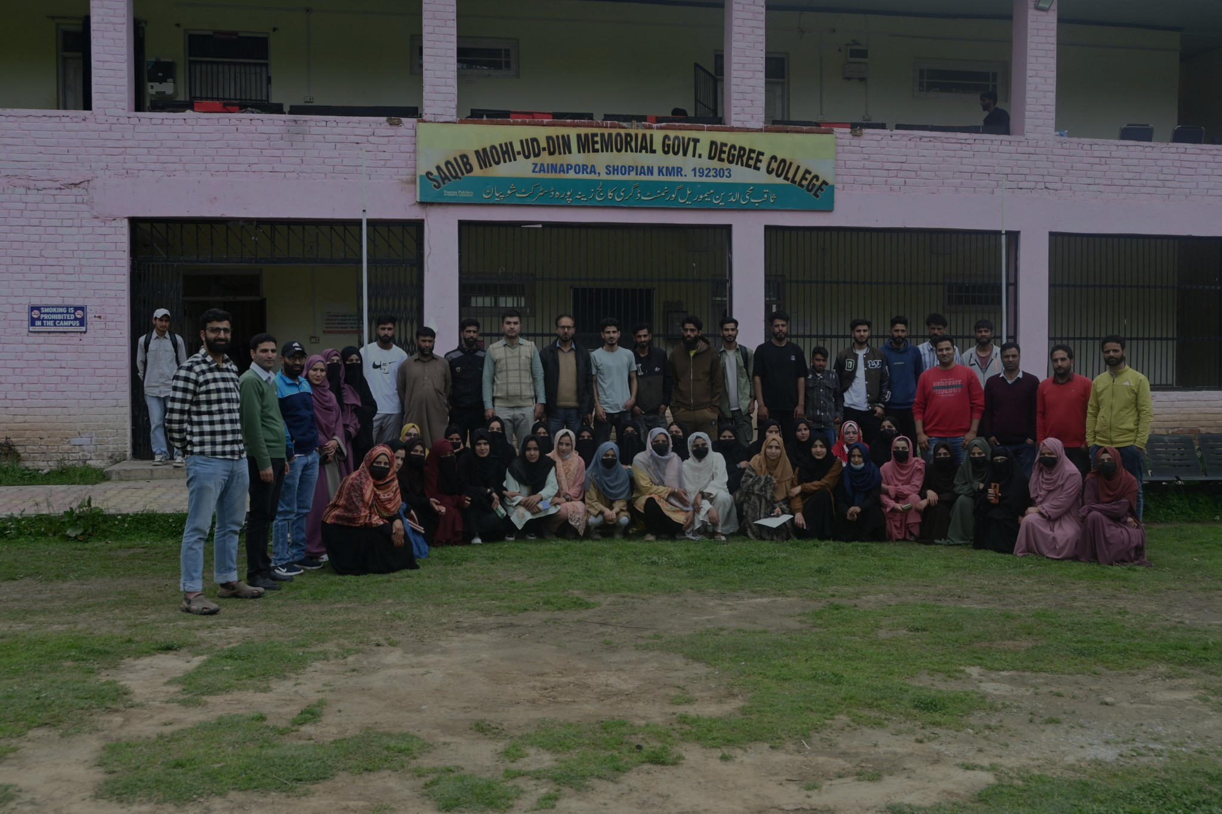
WELCOME TO
GOVT DEGREE COLLEGE ZAINAPORA
A Journey towards excellence
Theme: Shopian@100

Slide 2
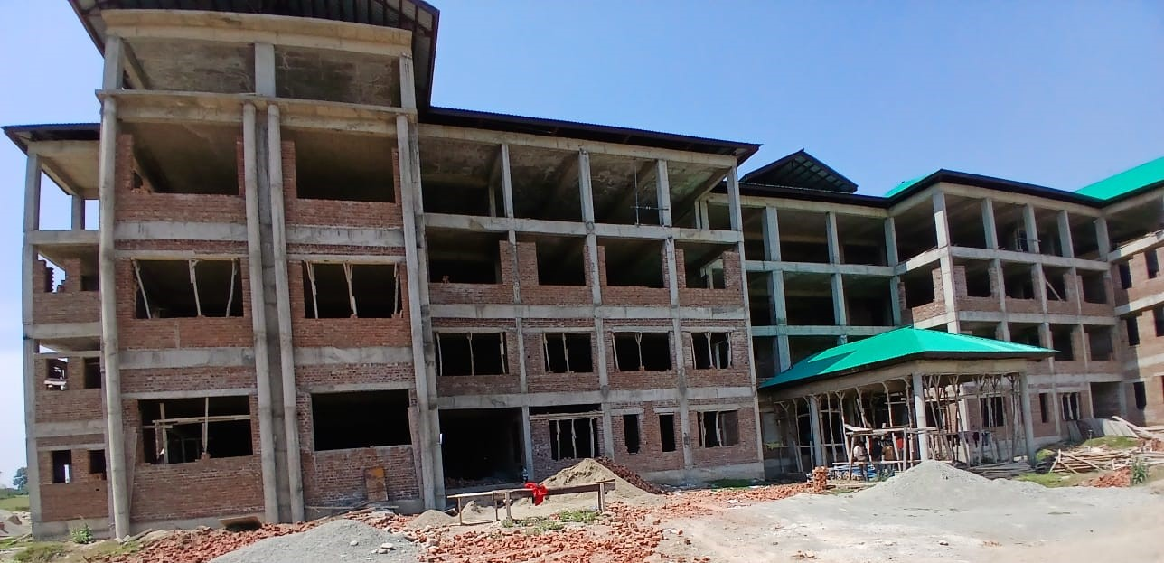
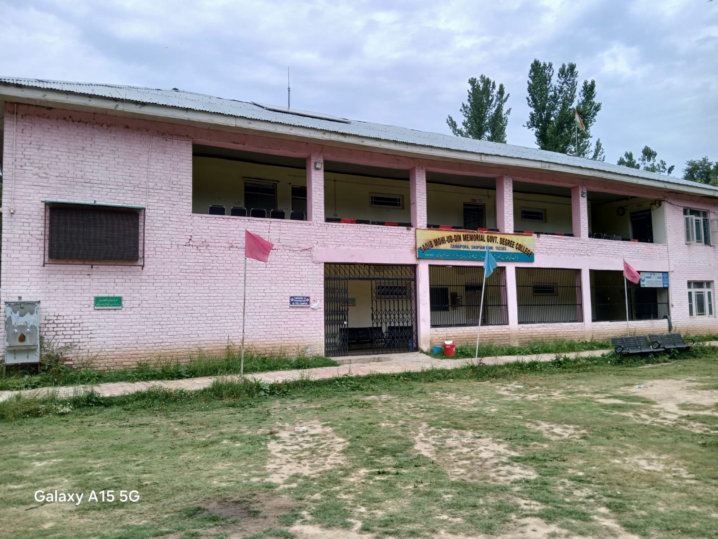
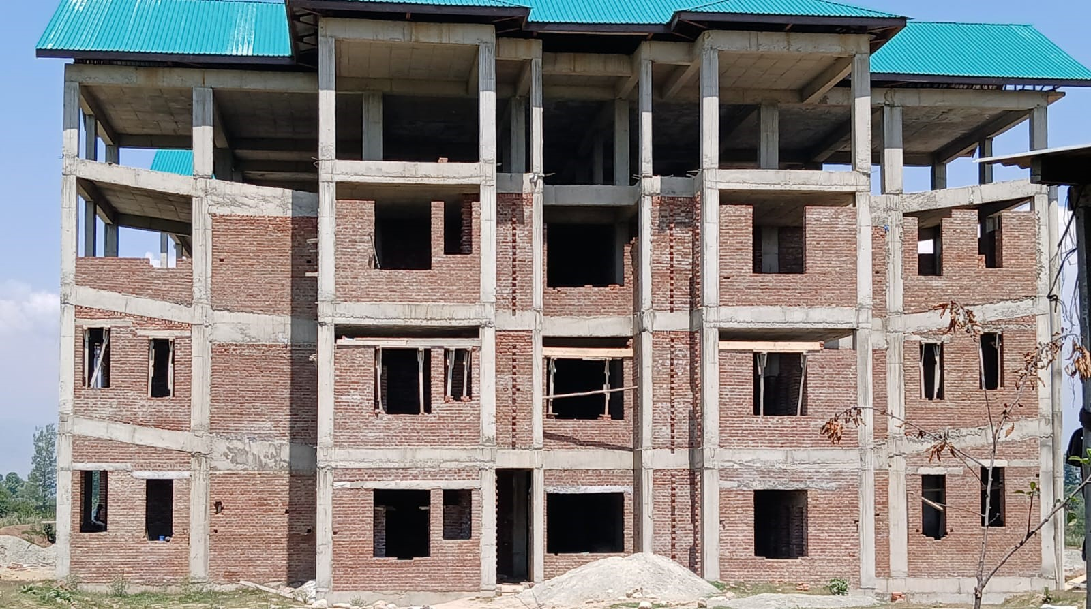
COLLEGE PROFILE
Established in March 2020, located 30 km’s from Shopian town on the Shopian-Bigbehra road
Currently operating in a makeshift building in Zainapora town
Offers admission in basic humanities subjects like Education, Political Science, Urdu, History , Kashmiri

Slide 3
VISION AND MISSION
1. Excellence in education: Cultivating confidence, creativity, and human values
2. Fostering a culture of action and inspired thinking
3. Developing enlightened human resources for the nation's future
4. Tailoring opportunities to students' intellectual and occupational needs
5. Imparting quality education for a better tomorrow
6. Nurturing positive learning attitudes, problem-solving skills, and addressing new educational concerns (e.g., value-oriented education, technology, counseling)

Slide 4
OBJECTIVES
To promote national integration and international understanding among students.
To guide students to choose profession as per their capacity or level of intellect.
To provide ideal, innovative and competent teachers to the society.
To develop democratic citizenship and personality of the students.
To provide value, moral and women Education.
To provide right kind of leadership to the society.

Slide 5
Sanctioned Strength (Teaching)
S. No | Subject Name | Sanctioned Strength
01 | English | 01
02 | Education | 01
03 | Urdu | 01
04 | Political Science | 01
05 | History | 00
06 | Kashmiri | 01
07 | PTI | 01

Slide 6
Sanctioned Strength (Non-Teaching)
S. No | Designation | Sanctioned Strength
01 | Accounts Assistant | 01
02 | Junior Assistant | 01
03 | Library Assistant | 01
04 | Orderly | 01
05 | Chowkidar | 01

Slide 7
TEACHING FACULTY
Head of Institute :
Prof. Mohammad Amin Sheikh |  |  | Principal
Teaching Faculty:
01 | Dr. Syed Riyaz Ahmad Shah | Assistant Professor | Education
02 | Dr. Yasir Ahmad Khanday | Assistant Professor | English
03 | Prof. Gulshana Akhter | Assistant Professor | Kashmiri

Slide 8
NON TEACHING FACULTY
Non Teaching Faculty
01 | Mr. Syed Lateef Ahmad Shah | Senior Lab Assistant
02 | Mr. Maloof Bashir | Junior Assistant
03 | Mr. Haris Fayaz | MTS

Slide 9
EXTRA CURRICULAR ACTIVITIES
PAINTING COMPETITION
QUIZ COMPETITION
ART COMPETITION
DIFFERENT SPORTS ACTIVITIES
CLEANLINESS DRIVE
DRUG AWARENESS CAMPAIGN
PLANTATION DRIVE
SIGNATURE CAMPAIGN

Slide 10
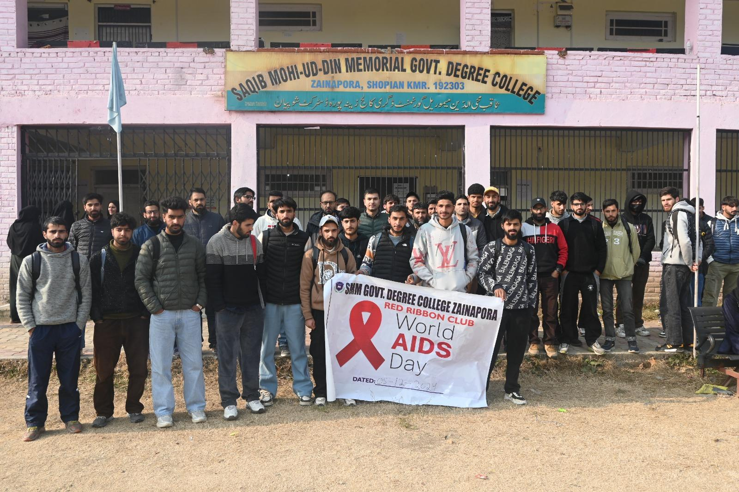
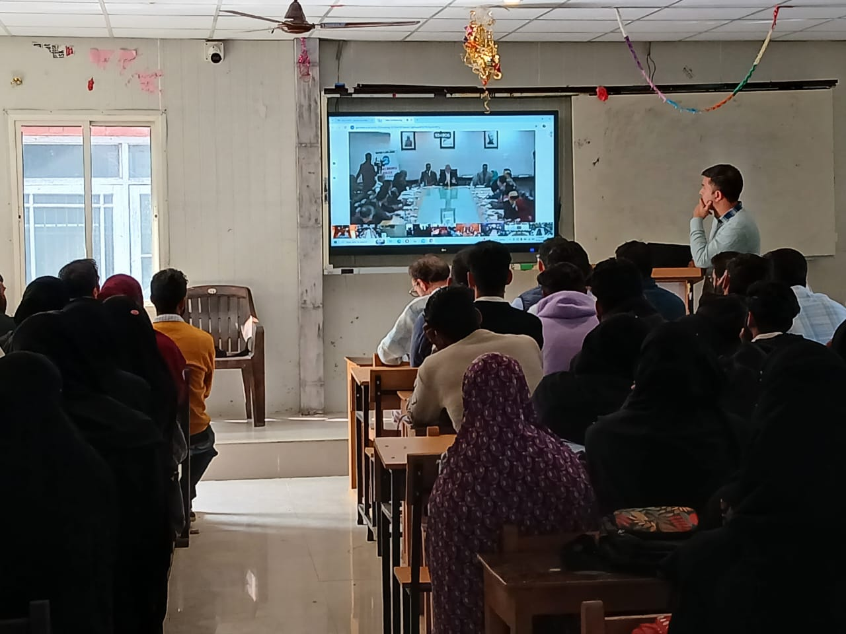
EXTRA CURRICULAR ACTIVITIES GALLERY

Slide 11
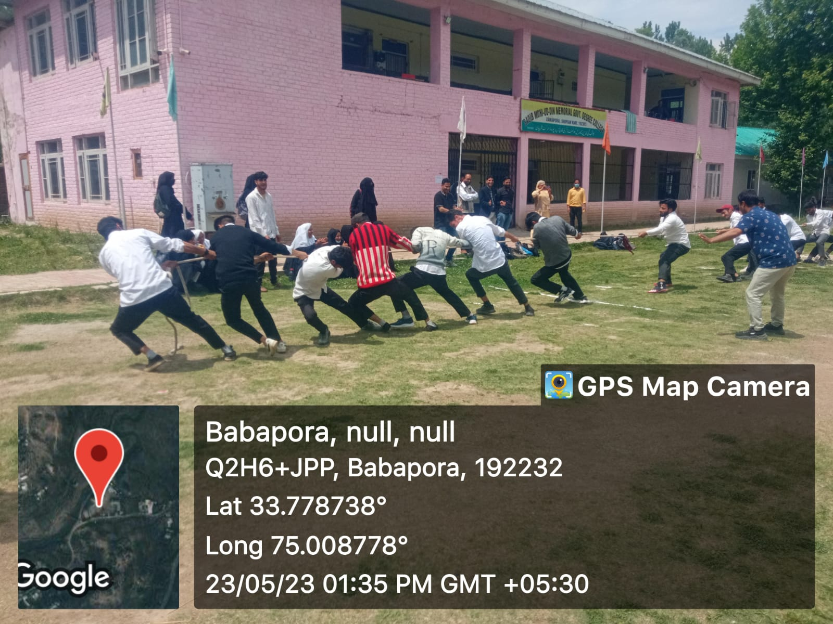
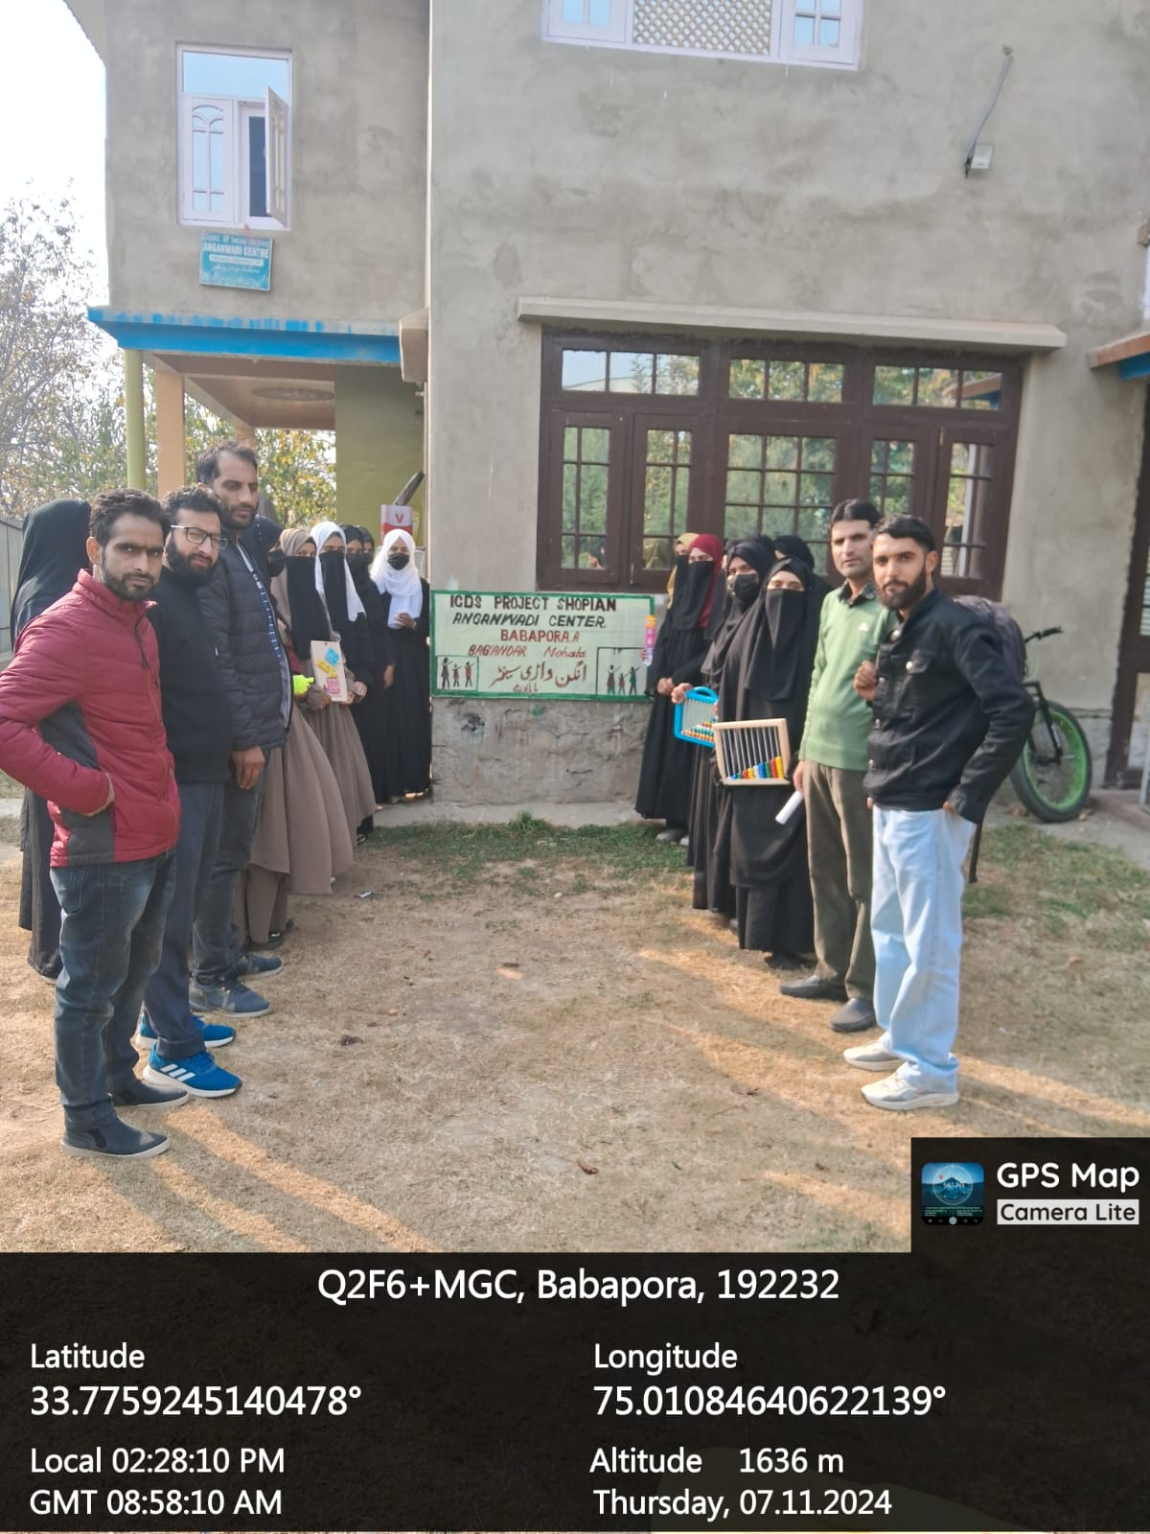
EXTRA CURRICULAR ACTIVITIES GALLERY

Slide 12
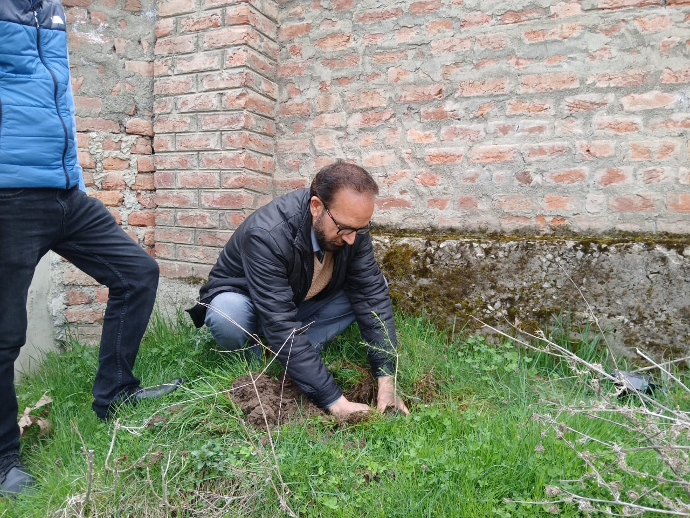
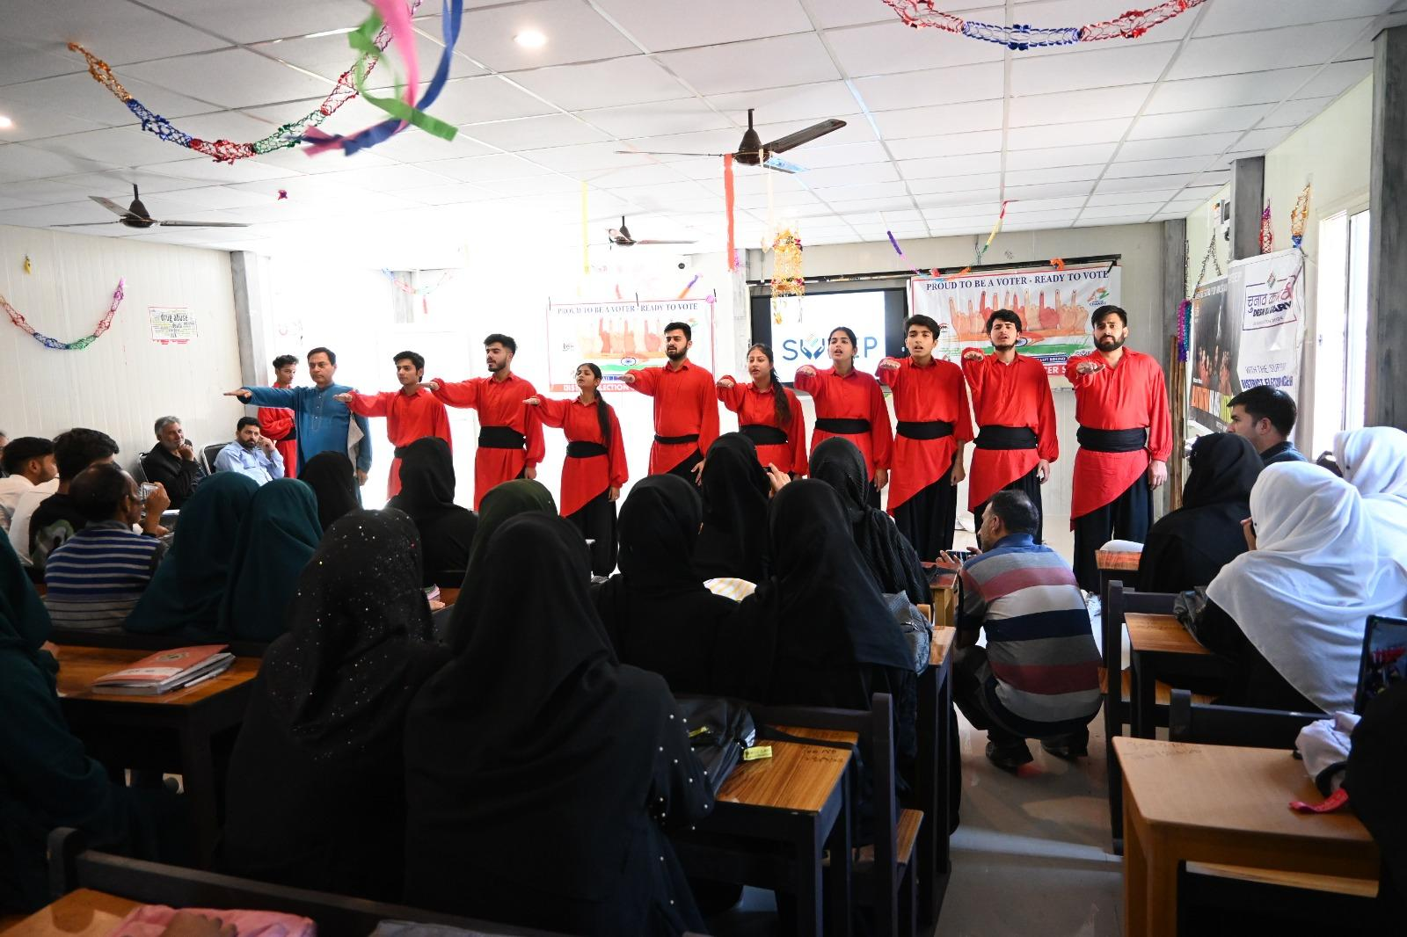
EXTRA CURRICULAR ACTIVITIES GALLERY

Slide 13
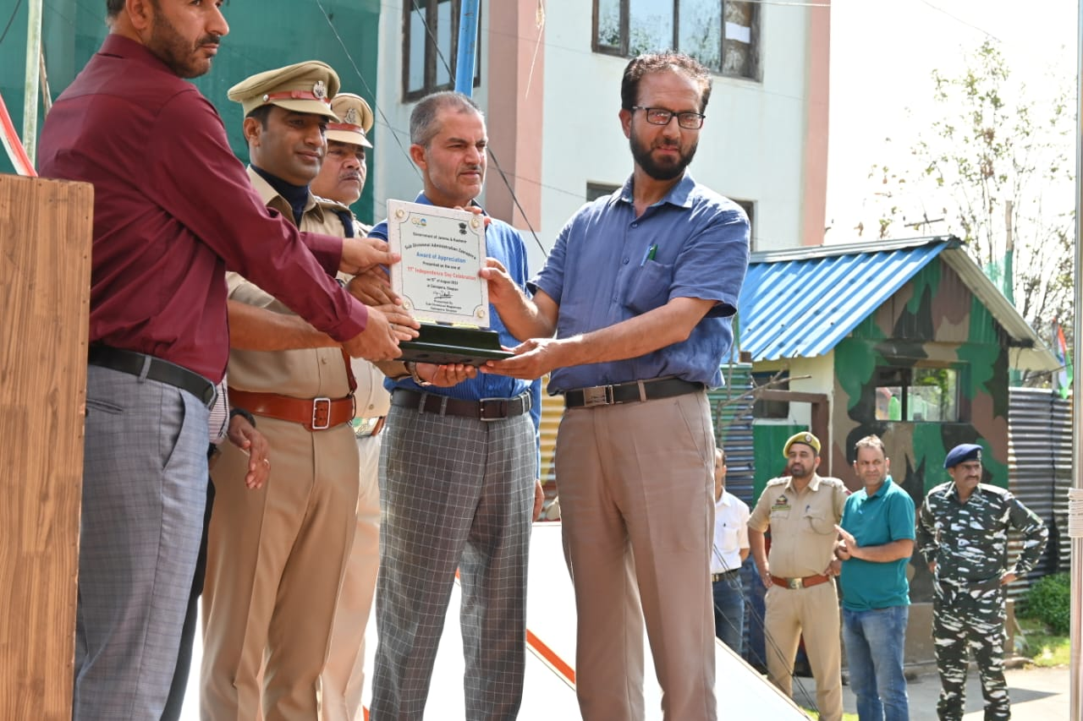
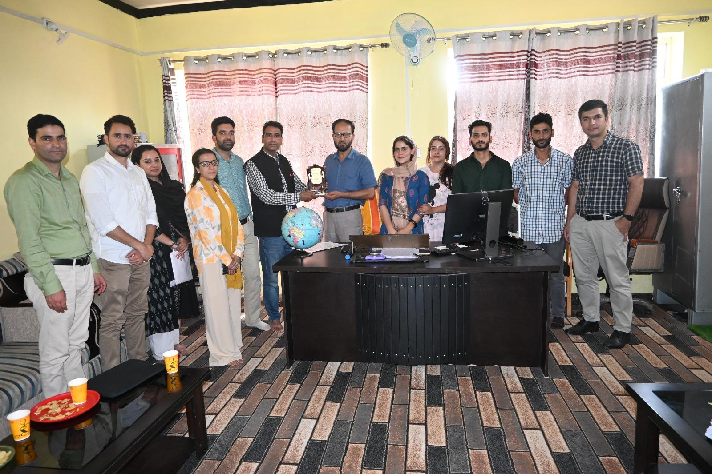
EXTRA CURRICULAR ACTIVITIES GALLERY

Slide 14
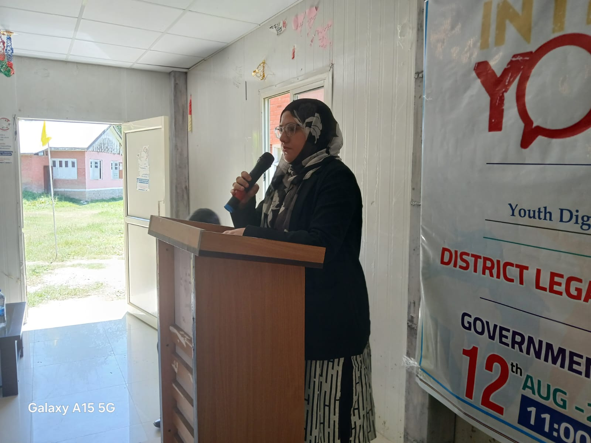
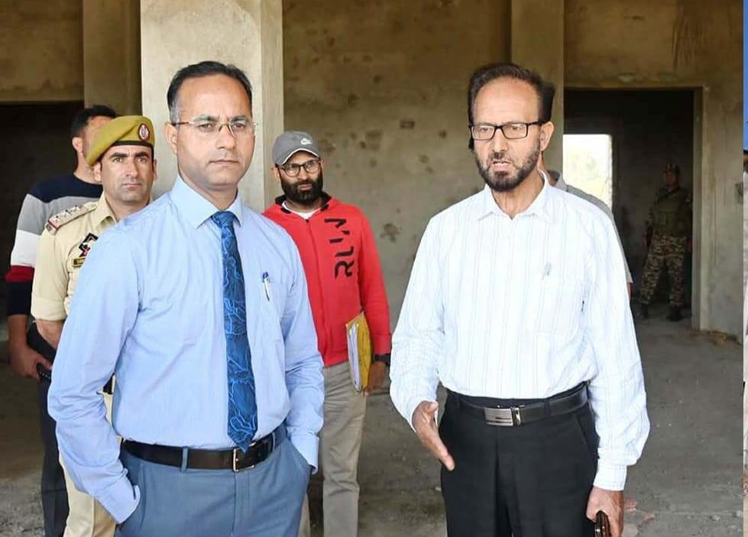
EXTRA CURRICULAR ACTIVITIES GALLERY

Slide 15
Enrollment of last 5 years
Year | No. of Enrolled Students
2020-2021 | 100
2021-2022 | 370
2022-2023 | 493
2023-2024 | 260
2024-2025 | 254

Slide 16
College Infrastructure
S.No | Item | No.
01 | Principal Chamber | 01
02 | Smart Classrooms | 04
03 | Examination hall/conference hall | 01
04 | Office Room | 01
05 | Staff Room | 01
06 | Store Room | 01
07 | Browsing Centre | 01
08 | Library | 01
09 | Washrooms | 04

Slide 17
PROGRAMS OFFERED
BA Honours with Education as Major
BA Honours with Political Science as Major
BA Honours with History as Major
BA Honours with Urdu as Major
BA Honours with Kashmiri as Major

Slide 18
SCHOLARSHIP AND FINANCIAL ASSISTANCE
Financial Assistance: Provided to poor, orphan, and handicapped students, sanctioned by the Principal after scrutiny by the Financial Assistance Committee.
Post-Matric Scholarship: Category as well as through NSP

Slide 19
COLLEGE BUILDING SPECIFICATION
G+3 WITH A PLINTH AREA OF 20264 Sq Ft
AA COST: 1884.67 LAKHS
ALLOTED COST: 1597.75 LAKHS
DATE OF START OF WORK: 30-07-2022

Slide 20
CURRENT STATUS OF COMPLETION
PHYSICAL : 80% COMPLETED
FINANCIAL: 80% COMPLETED
EXPECTED DATE OF COMPLETION: JULY 2025

Slide 21
EXPENDITURE STATUS
FUNDS RELEASED TILL DATE: 1188 LAKHS (74% OF TOTAL FUNDS)
EXPENDITURE TILL DATE: 1188 LAKHS

Slide 22
WORK DONE FROM 2020 TO 2024
1.Renovation of Makeshift building through R&B
Estimated Cost 12 lakh for the establishment of 3 washrooms, gate for college, iron grill ,windows/doors,as well as verandah
2.Two Prefabricated Huts for students through SICOP with an area of 30/50 at an estimated cost of 46 lakhs
3.Browsing Centre for college students at an estimation of 20 lakhs(36 computers).
4.Books for students upto 12 lakhs(more than 4000 books)

Slide 23
VISION/PLAN FOR NEXT 25 YEARS
1. Introduction of more arts subjects.
2.Introduction of science/Commerce stream
3.Skill oriented Courses
4.Wifi facilities for students
5. 24/7 reading facilities for the students.
6.Compound wall for College
7.Proper landscape
8.Hostel facilities for staff and students.
9.Recreation Halls for the students.

Slide 24
VISION/PLAN FOR NEXT 25 YEARS
10. TT Hall/indoor games
11. Gem centre.
12. Conteen
13 .Browsing centre with well equipped wifi facility.
14. Transport facilities for students.
15. Well equipped science labs
16. Psychological lab/language labs.
17. Smart classrooms

Slide 25
VISION/PLAN FOR NEXT 25 YEARS
18. Special Classrooms for Visually, Hearing, orthopedic, Speech impairment students.
19. Single window system
20. Research Opportunities
21. Industry and Internship Collaboration
22. Skill Development Programs
23. Hybrid Learning System
24. Carrier Services
25. College Transportation

